Slide 1

Project developed and designed by,
SHUBHAM RATH(B115053)
RAJASRSHI KHARE
SHRUTI SINGH
SAROJ SETHY

Slide 2
WORKING PROJECT
The public works department(PWD) of Government of Odisha is responsible for maintenance of public properties like parks ,vending zones ,streets ,street lights etc.A citizen can lodge a complaint regarding any kind of malfunctioning of the above properties .Before lodging any complaint a citizen should register himself/herself first. Upon registration, the citizen shall be provided with a unique ID which he/she can use for further logging in and checking the status of the complaint. For each complain, a complain ID is also generated. In this project proper interfaces are provided both for administrator as well as users console to perform the respective functions.

Slide 3
PURPOSE AND MOTIVATION for THE PROJECT
The project aims at the common issues that we face in our day to day life due to poor working conditions of the public properties of our city. It is the responsibility of the government to take care of such problems and find a solution as soon as possible. And as a responsible citizen of our country, it is our duty to report any such problem so that it can solved in the least possible time. This project provides an interface to the user though which he/she can lodge a complaint and check the status of same in an organized manner. Through this project, we aim to develop the society and make it a desirable place to live in.

Slide 4
FEATURES OF THE PROJECT
The interface allows the user to register in order to file a complaint. Upon registration, the user is provided with a registration ID through which the user can login again and again to check the status of the complaint. Now the console asks the user to file a complaint. Upon entering, he is provided with a specific complain ID
The interface also allows the administrator to login ,check and update status of complaints, check the users profile , add notices. The user can see these notices.

Slide 5
CLASSES, FUNCTIONS, TEMPLATES USED
Class registration: //To register a new college
registeration() //Constructor to input details
void csvinput(registeration r) //To write to csv file

Slide 6
CLASSES, FUNCTIONS, TEMPLATES USED
Class College_Details: //To edit details of existing college
College_Details(std::string collegename) //To enter details of college
void csveditinput(College_Details ob) //To write details to csv file
void csvedit(std::string collegename) //To clear screen and call the above functions

Slide 7
CLASSES, FUNCTIONS, TEMPLATES USED
Class grant: //For grant related operations
void get_grant() //To input new grant value
void rate_calc(std::string); //To calculate rate for grant
void grant_increase(std::string); //To increase grant on existing projects
void found(grant); //To calculate respective grants
void new_grantfunc(std::string); //To input & check for new project grant
Others:
void grant_edit(double g, std::string c, int f) //To write grant to csv file
Template T // To convert double to string

Slide 8
CLASSES, FUNCTIONS, TEMPLATES USED
Class credentials: //For login operations
void getusername() //To input user name
void getpassword() //To input password
friend int usercredential(credentials/registration) //Overloaded function to check for correct user & password
friend int adminkey(credentials) //To check for correct admin
Class encryption: //To encrypt & decrypt password

Slide 9
CLASSES, FUNCTIONS, TEMPLATES USED
Others:
main()
int loginoption() //Main Login screen
void useroperationui(std::string collegename) //User operations menu
void userui() //User login screen
void adminui() //Admin login screen
void adminoperation() //Admin Operations menu
void edit_password() //Admin password editor
void list() //Lists the colleges in database

Slide 10
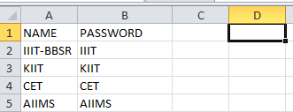
CSV FILES
Five csv files are used.
usercredential.csv

Slide 11
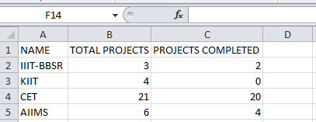
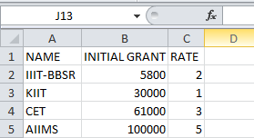
CSV FILES
2. project.csv:
3. grant.csv:

Slide 12
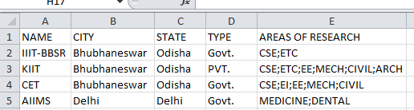

CSV FILES
4. college_details.csv:
5. admincredentials.csv

Slide 13
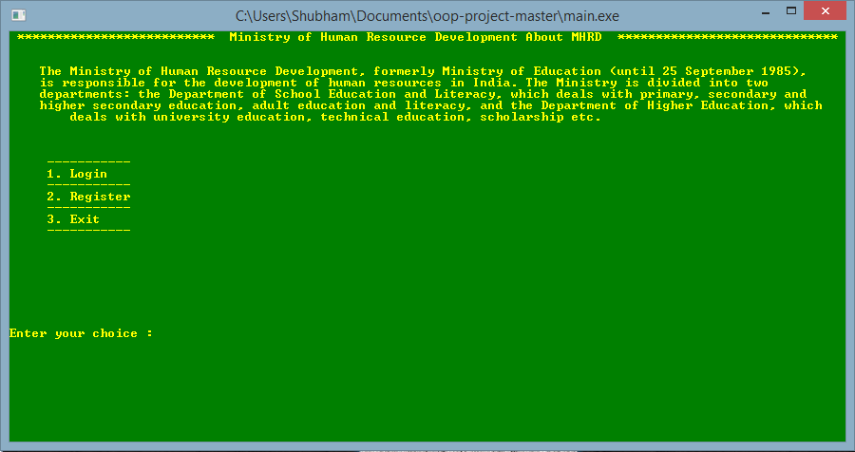
MAIN UI

Slide 14
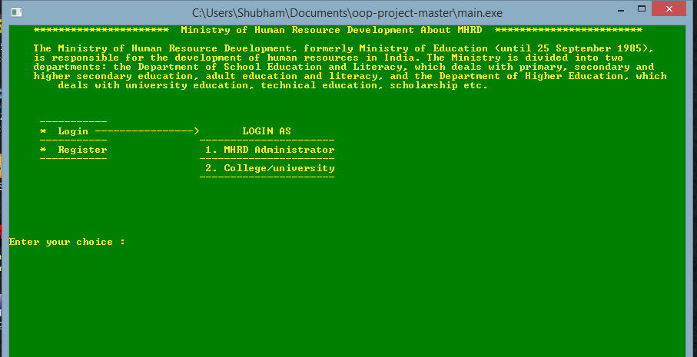
MAIN UI LOGIN

Slide 15
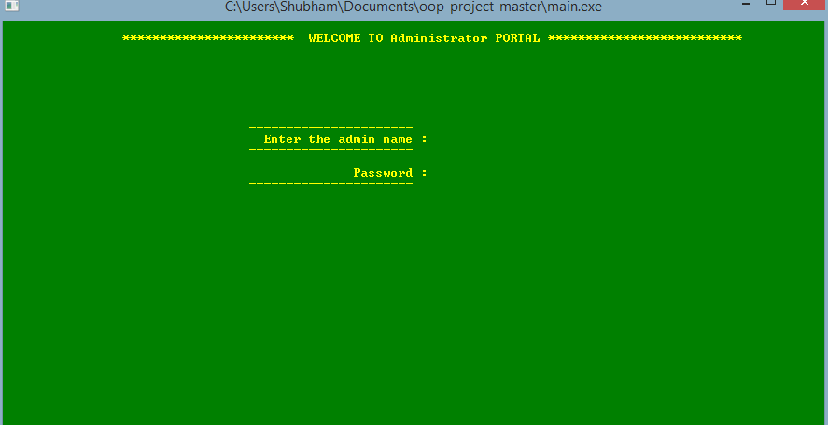
ADMIN LOGIN

Slide 16
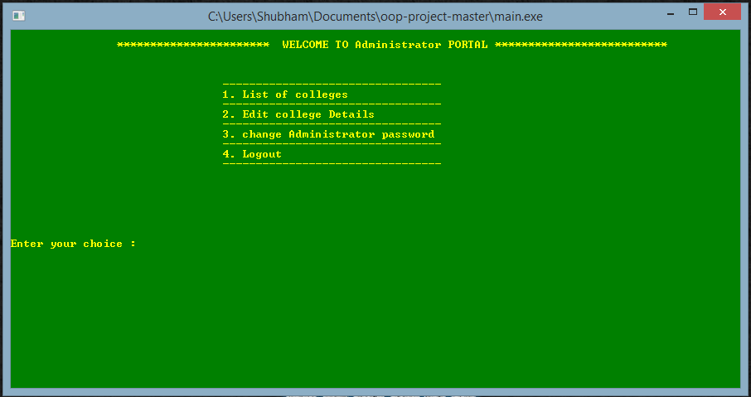
ADMIN OPERATIONS

Slide 17
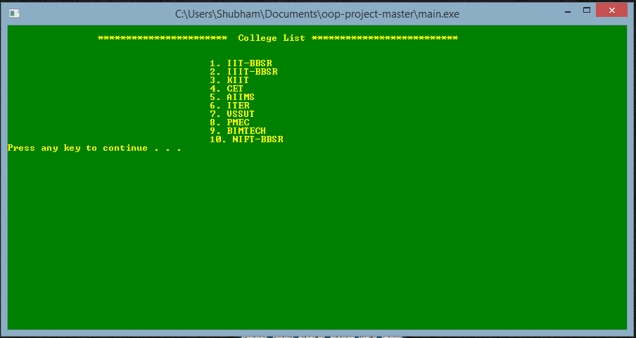
LISTING COLLEGES

Slide 18
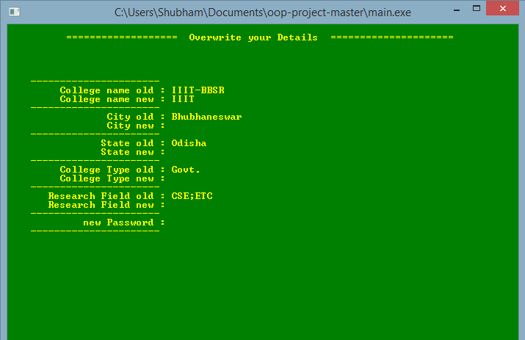
EDITING COLLEGE DETAILS

Slide 19
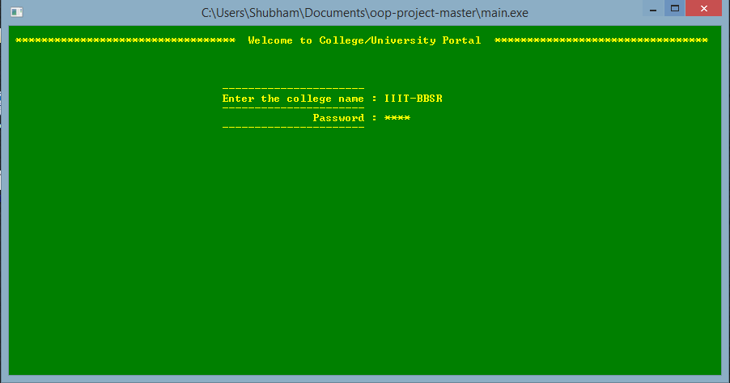
USER/COLLEGE LOGIN

Slide 20
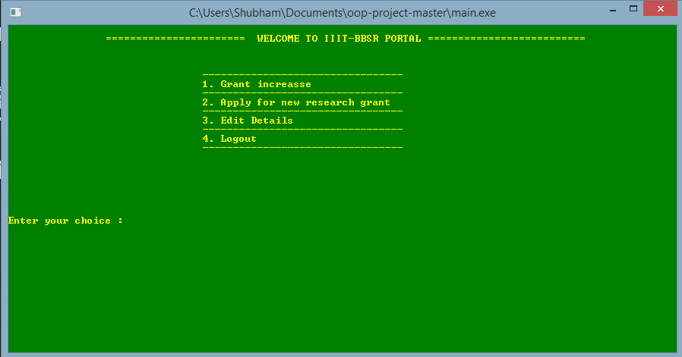
USER/COLLEGE OPERATIONS

Slide 21
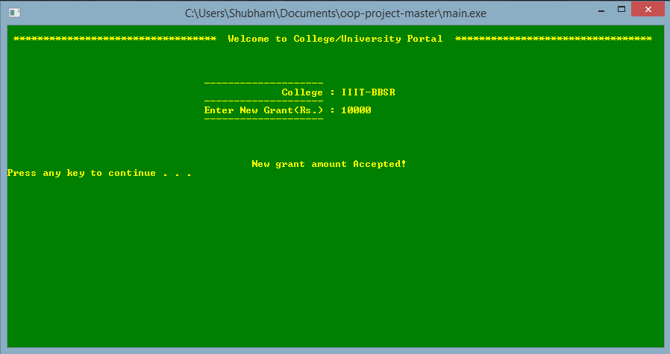
GRANT HIKE FOR PRESENT PROJECT

Slide 22
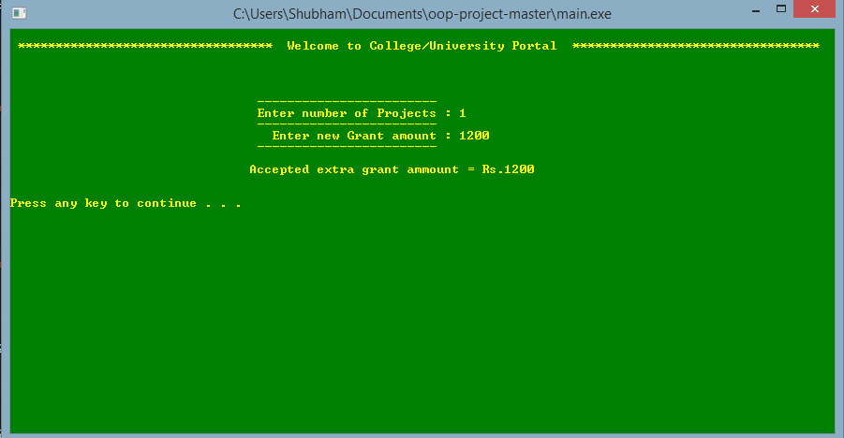
GRANT REQUEST FOR NEW PROJECT

Slide 23
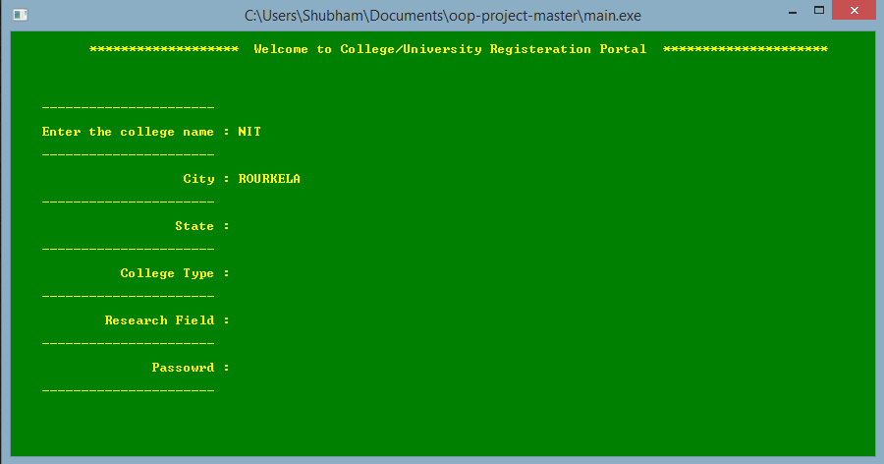
NEW USER/COLLEGE REGISTRATION

Slide 24
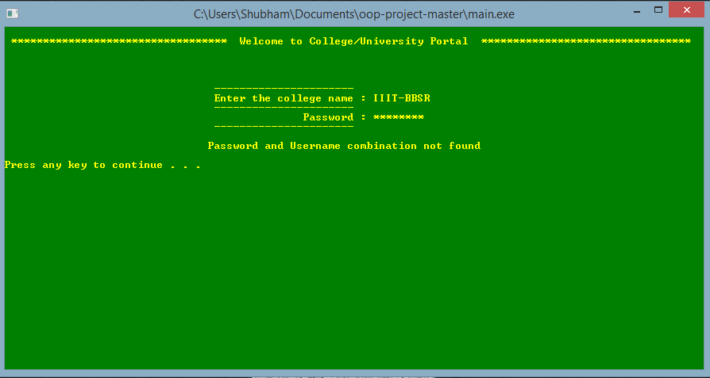
PASSWORD PROTECTION

Slide 25
THANK YOU

